Slide 1
Chapter 20

Slide 2
Why Principal components analysis?
Typical data mining exercise may have more than 100 variables
With so many variables input data is likely to be sparse
More variables increase the problem of overfitting
PCA combines information from existing variables to create a reduced set of variables.

Slide 3
Consider this example
A customer who spends a lot of money in total
spends a lot of money in any given month
spends a lot of money over any given year
Such high correlated variables get weighted more in clustering models
2 “high-spending” customers may look closer than they are because multiple variables focus on one aspect of the data—total spending

Slide 4
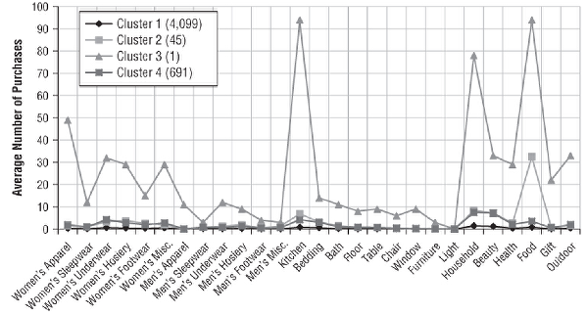
Customers who purchased once even though from different depts, got put into 1 cluster.
Cluster 3 has only 1 customer

Slide 5
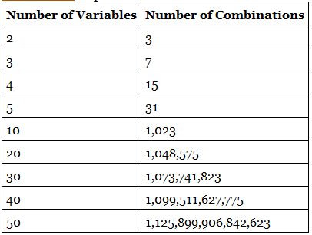
Why enumeration may not work?

Slide 6
Variable selection techniques concern
Forward selection in regressions and decision trees use a target variable to select the best input variables.
Information from the target leaks into the model by affecting the choice of variables.
It is generally not problematic since we validate model using a validation set.

Slide 7
Regression (recap)
In regression, under forward selection,
we keep adding variables till adjusted-R² improves
One variable is added at a time, and the variable added is the one that gives the maximum increase in R²
Why variable with second-highest R² in the first round always chosen for the second round?
Stepwise selection: After adding one, a variable can be removed as well;
Forward selection with logistic regression to select the variables for a neural network works well.
Backward selection is typically not used.

Slide 8
Regression (recap cntd.)
Regression good for global patterns.
Decision trees, neural networks are good for local patterns,

Slide 9
Difference between decision-tree and regression?
Similarity:
Both can help in identifying important variables.
Dissimilarity:
Decision-tree also specify the cut-off value or the combination of factors, based on which split happens
Decision-tree captures local patters.
Next best variables are specific to child nodes in decision-trees; whereas next variable is built on the entire data set in regression.
Decision-trees can pick variables that are highly correlated, so remove highly correlated variables before building a decision tree

Slide 10
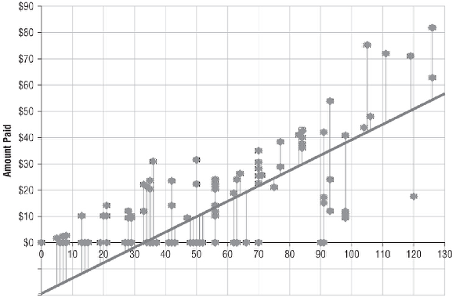
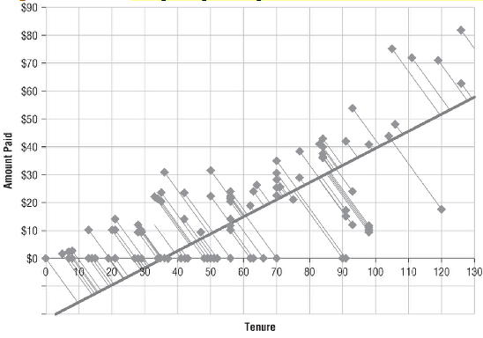
Principal Components
First principal component is the one that maximizes the variance of the projection of the input points onto the line.
Principal component makes sense only on input variables

Slide 11
Principal components (cntd.)
Principal components are orthogonal to each other.
Principal components are sensitive to units, therefore standardizing the inputs would be a good idea.
When using categorical variables, reducing number of variables is difficult.
Principal component is a linear combination of all the variables.

Slide 12
Principal components (cntd.)
Principal components are extracted sequentially, with the first PC accounting for the most variance in the data.
PC₍₁₎ is a vector that points in the direction in which the data are most “spread out”.
Each PC captures variance less than the previous PCs.
Typically we use far less number of principal components

Slide 13
PCA vs Factor analysis
PCA is used to find optimal way of combining variables into a small number of subsets; while FA is used to identify latent factors underlying variables.
Both are useful in situations where the dimensionality of data, its structural composition is not well known.
Facotrs in FA are conceptualized as “real world” entities such as depression, anxiety, and disturbed thought; whereas, components are simple geometrical abstractions that may not map to real world concept.

